Slide 1
Introduction to HCI and User-Centered Design

Slide 2
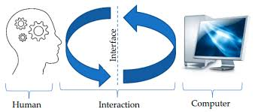
What is HCI?
Human-Computer Interaction (HCI) is the:
academic study and design practice of how people interact with computers and technologies.
It bridges computer science, behavioral psychology, design to ensure technology is usable, effective, and efficient.

Slide 3
1. Introduction to HCI
Component of HCI | Description
User | Humans with different cognitive and physical abilities who use the system.
Computer | Hardware and software including input/output devices (touch, voice, screen).
Interaction | The communication between the user and the computer.
Importance of HCI (area) | Why It Matters
Usability & Safety | Reduces errors and prevents failures in critical systems.
Productivity | Increases speed and efficiency of tasks.
Market Success | Improves user satisfaction and product competitiveness.
Notes:
relating to or involving the processes of thinking and reasoning: is cognitive

Slide 4
Real-Life Example:
ATM machine interface
Mobile apps
University LMS
E-commerce websites

Slide 5
2. Evolution of HCI
Era | Technology / Interface | Key Characteristics
1960s–70s | Batch Processing & CLI | Users typed rigid text commands; expert-driven interaction.
1980s | GUI (Graphical User Interface) | Introduced icons, windows, menus, mouse; more user-friendly.
1990s–2000s | Web & Mobile | Internet browsers and touchscreens; intuitive navigation; widespread computing.
2010s–Present | NUI & Immersive Tech | Natural interaction through touch, voice, gestures. Includes AR & VR.
Future Trend | Voice, Gesture & BCI | Moving toward voice assistants, gesture control, and Brain-Computer Interfaces.

Slide 6
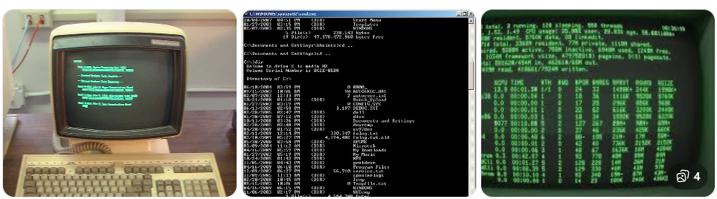
1. Command Line Interface (CLI)
Users typed commands, No graphics, Required technical knowledge
Example: dir, cd, copy
Only experts could use computers.

Slide 7
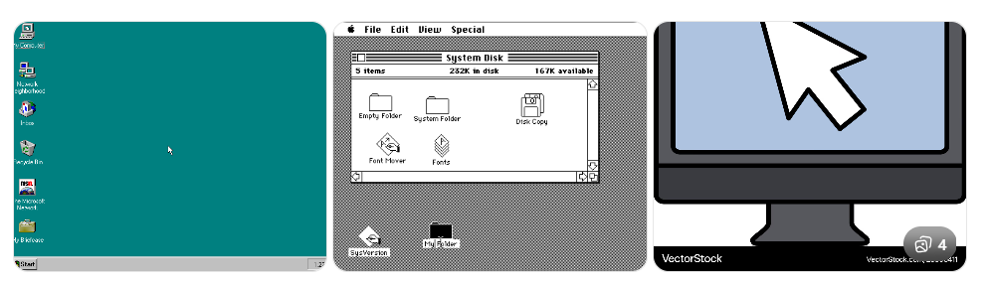
2. Graphical User Interface (GUI)
Introduced windows, icons, menus, mouse
Easier for normal users
Examples:
Microsoft Windows
macOS
Computers became accessible to everyone.

Slide 8
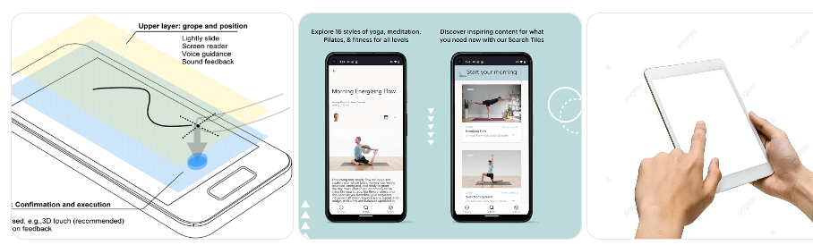
3. Touch & Mobile Interfaces
Touch gestures (tap, swipe, pinch)
Mobile-first design
Examples:
Android
iOS

Slide 9
4. Voice Interfaces
Examples:
Siri
Google Assistant
Users interact using voice commands.

Slide 10
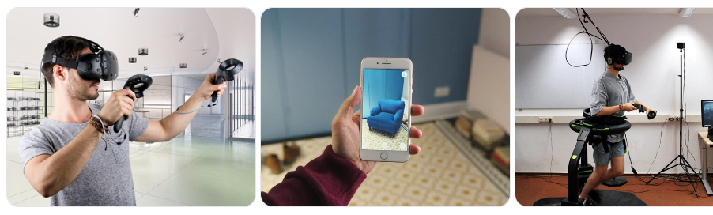
5. AR/VR Interfaces
Immersive interaction
3D environments
Used in gaming, education, healthcare

Slide 11
3. User-Centered Design (UCD) & Principles
User-Centered Design (UCD) is a design approach that focuses on users’
Needs
Goals
limitations at every stage of development.
Instead of asking: “What technology can do?”
We ask: “What does the user need?”

Slide 12
UCD Principles
In order to evaluate a particular system with respect to HCI we use these points known as UCD Principles are identified as
Simplicity
Visibility
Feedback
Accessibility
Consistency.

Slide 13
4️. HCI in Modern Software Development
Today, HCI is part of:
1. UI/UX Design
User Interface (UI) → Visual layout
User Experience (UX) → Overall experience
2. Agile Development
Continuous user feedback
Iterative improvements
3. Mobile & Web Apps
Companies focus heavily on UX.
Example:
Google
Apple Inc.
These companies invest heavily in usability testing.

Slide 14
Accessibility
Designing for:
Elderly users
Disabled users
Non-technical users
Example:
Screen readers
Voice commands
Large text options

